Slide 1
Bluetooth Low Energy (BLE) Receiver Front End Design Presented By Nichole Klipper Albertine Byemba-Kilongo Sai Anirudh Godavarthi Karthik Dorepally

Slide 2

Basic Design

Slide 3
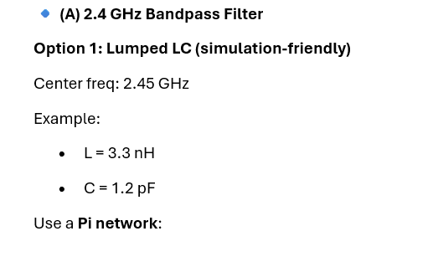
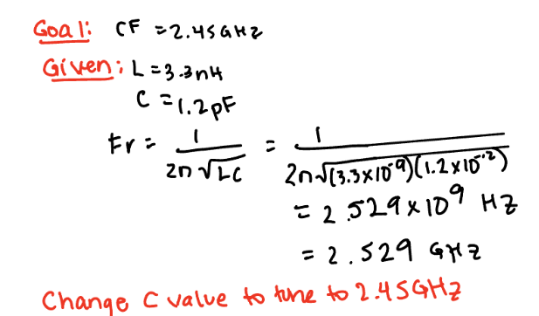
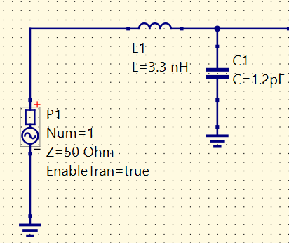

Slide 4
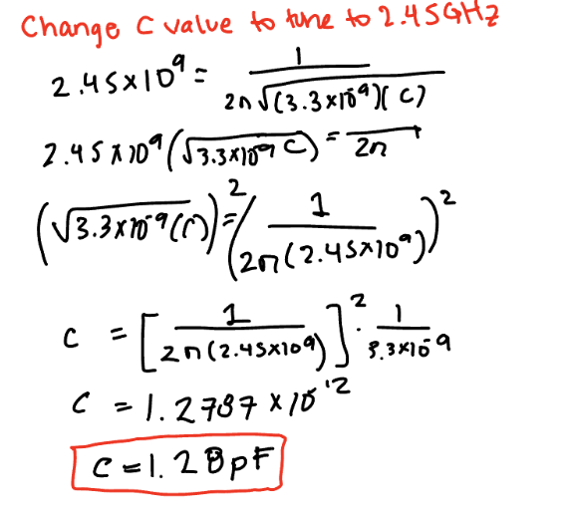
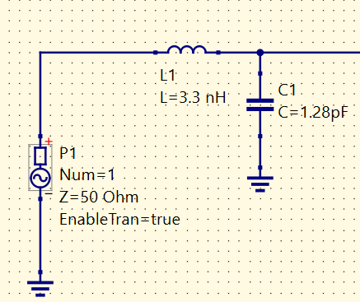

Slide 5
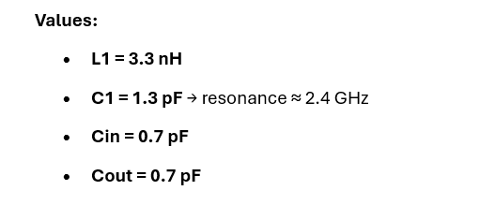
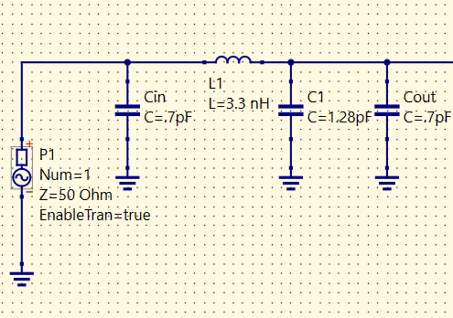
Add recommended coupling capacitors

Slide 6
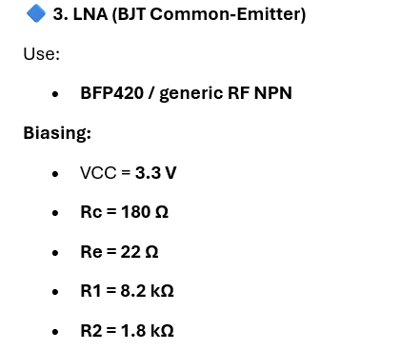
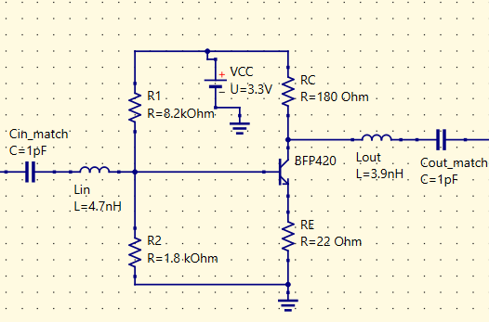
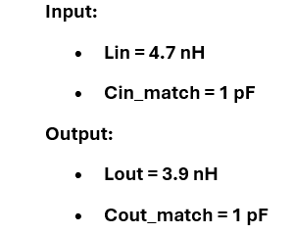

Slide 7
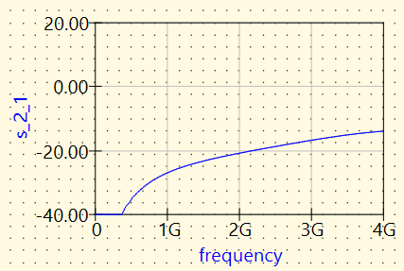
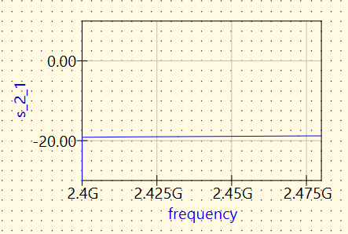

Expected gain: 10-15 dB
Actual gain: ~ 0 dB
Gain =$\frac{V_{out}}{V_{in}}$
Solution:
Reduce resistance at input (R1)
Turns on transistor
Replace R3 with inductor
Maximize load impedance

Slide 8
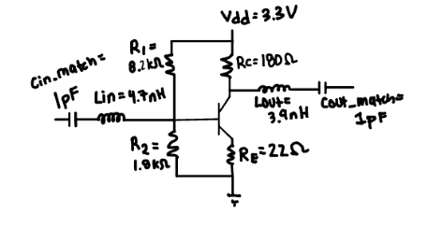
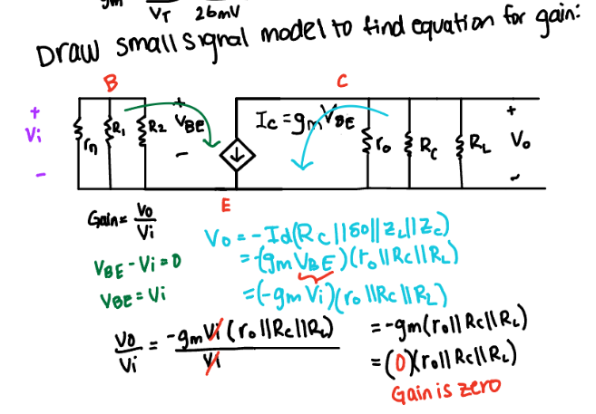
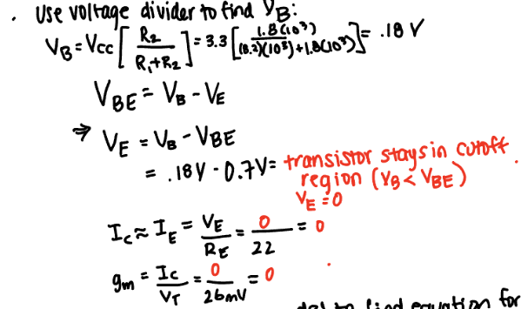
Why original circuit has 0 dB gain:

Slide 9
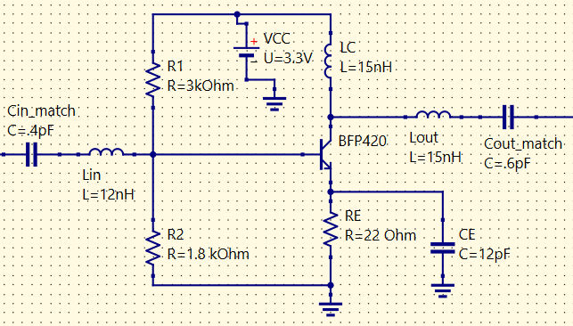
Fixing circuit:
Reduce R1, Cin_match, Cout_match
Increase Lin, Lout
Add CE
Change RC to LC

Slide 10
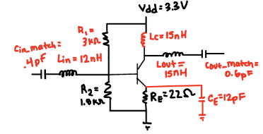
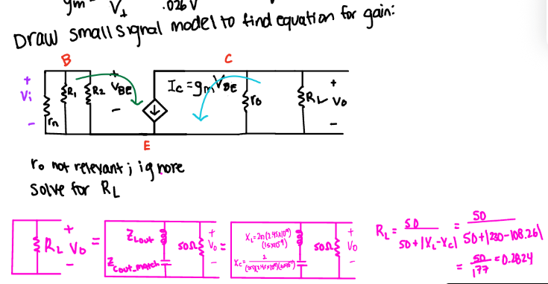
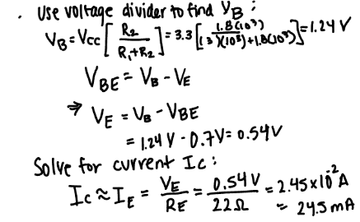
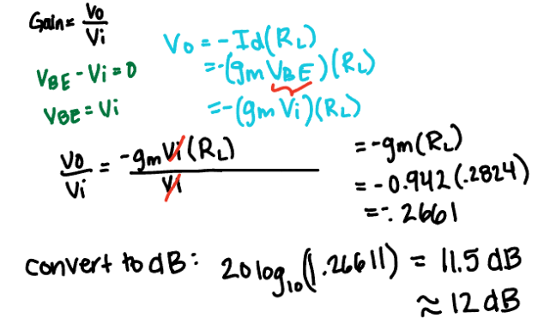

Derivation of gain from new circuit parameters:

Slide 11
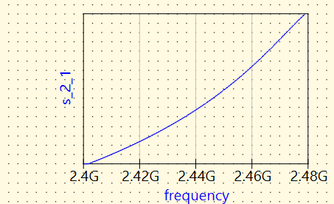
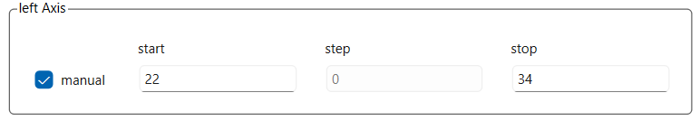
Expected gain: 10-15 dB
Actual gain: 12 dB
34 dB
22 dB

Slide 12
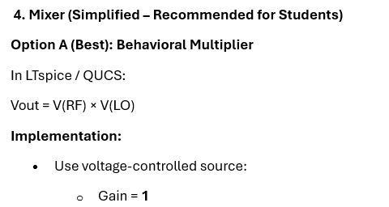
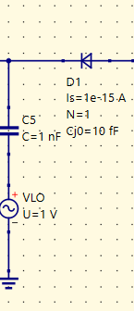
Diode and capacitor act as simplest Mixer
Math gets complicated so replace diode and capacitor with equation defined device (next slide)

Slide 13
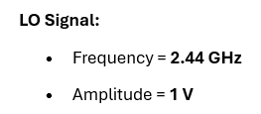
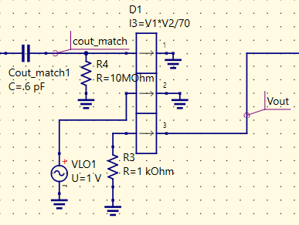
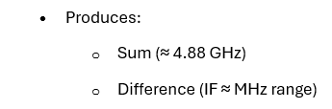
Equation Defined Device acts as mixer
cout_match wire acts as V(RF)
Vout wire acts as Vout
VLO voltage source acts as V(LO)

Slide 14
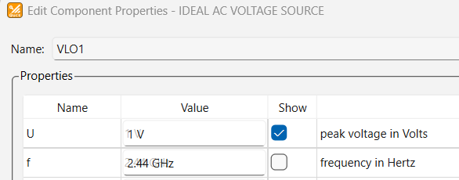

Slide 15
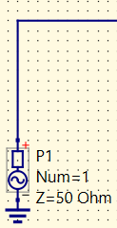
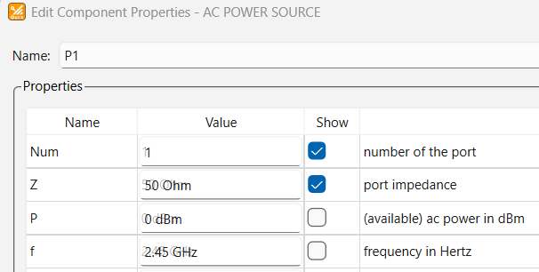
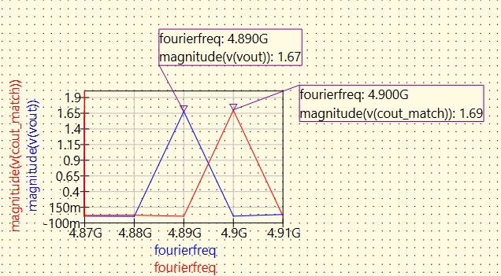
...
2.45 GHz + 2.44 GHz ~ 4.89 GHz (with some difference)
Fourier simulation shows the 2 peaks are at 4.89 GHz and 4.9 GHz... which are within 10 MHz of each other

Slide 16
Gain = Vout/Vin = magnitude(v(vout))/(magnitude(v(cout_match)) = 1.67/1.69 = .988 ~ 1

Slide 17
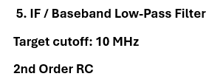
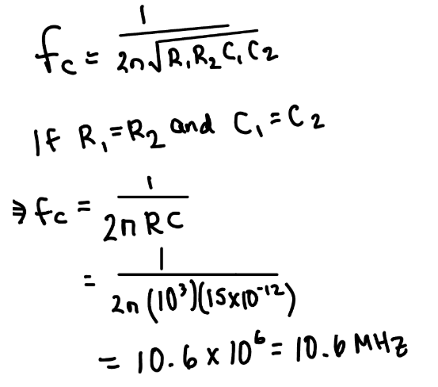
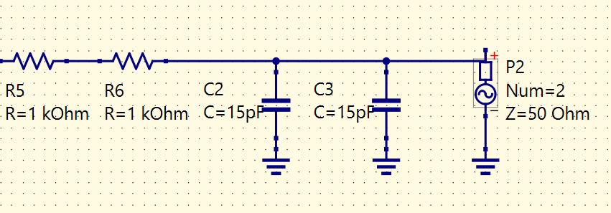

Slide 18
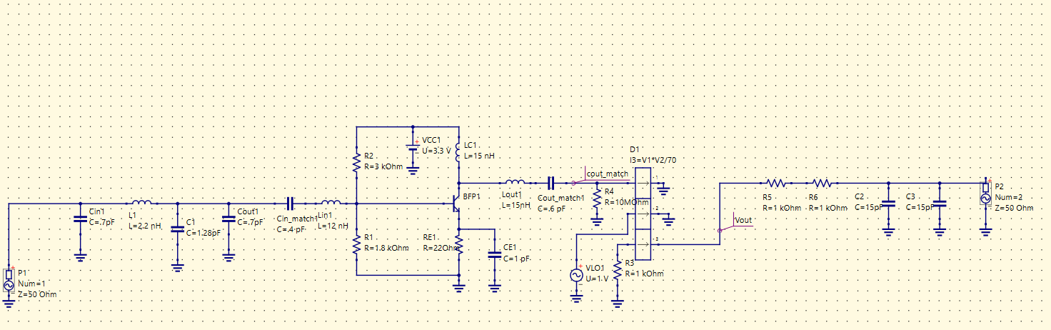
Final Circuit

Slide 19
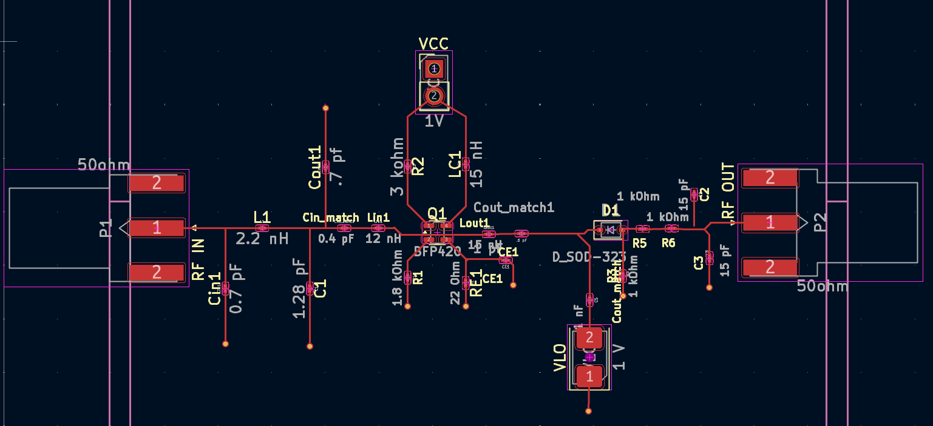
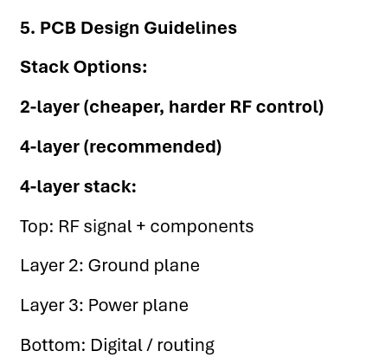
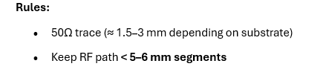
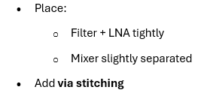
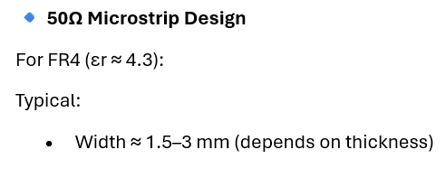
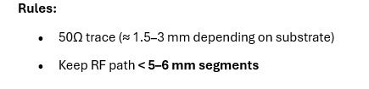
PCB Design

Slide 20
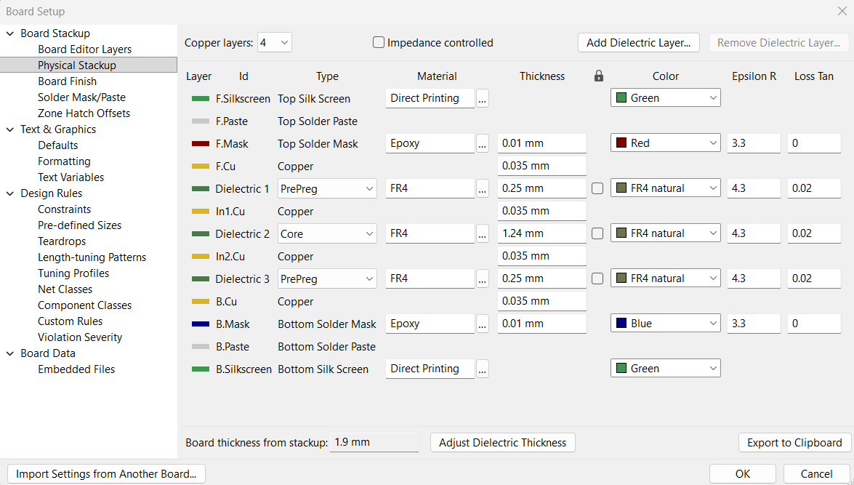
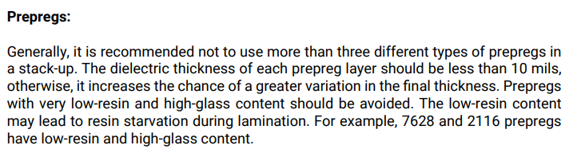
PCB Design – Board Setup (Physical Stackup)
10 mil = 0.254 mm

Slide 21
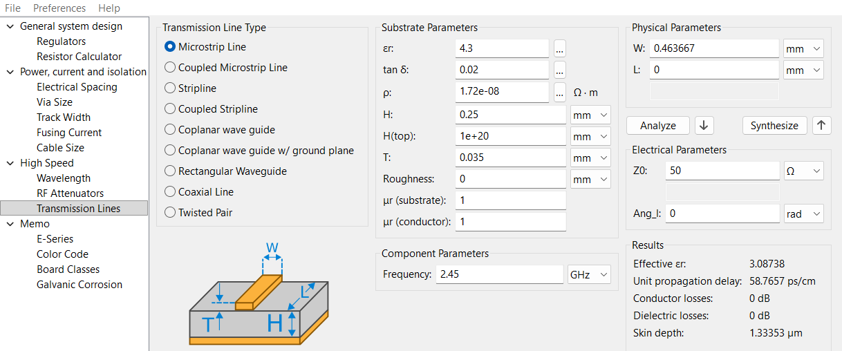
PCB Design – PCB Calculations
Original Set up using:
Er = 4.3
H = 0.25 mm (from Board Setup)
T = 0.035 mm (from Board Setup)
Freq = 2.45 GHz
Desired trace width:
1.5 - 3mm
Actual trace width:
0.46 mm

Slide 22
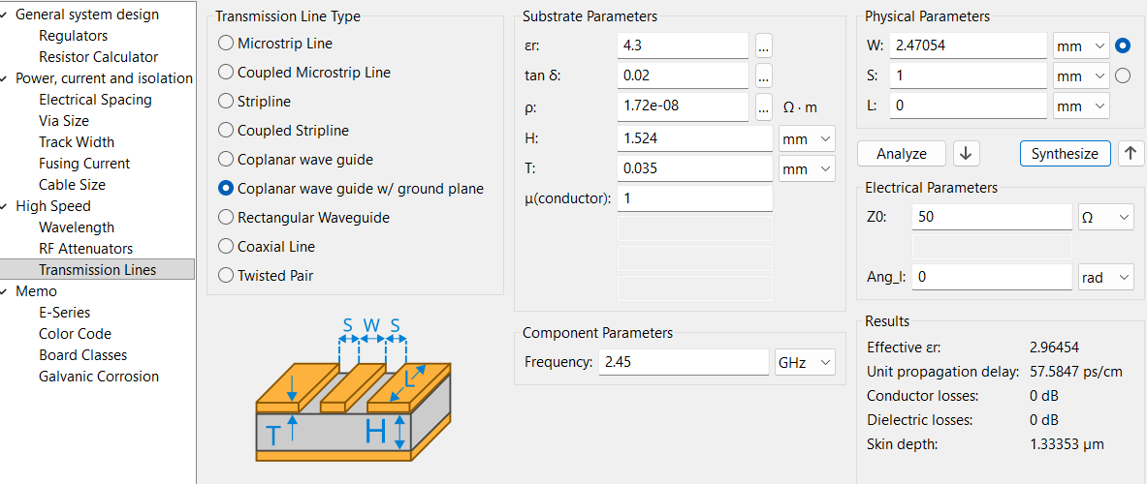
PCB Design – PCB Calculations
Solutions to increase trace width:
Increase dielectric constant
Can't change because requirement
Increase substrate height
Limited to .254 (10 mil) for prepreg
Switch from microstrip to coplanar wave guide w/ground plane
With gap = 1 mm, increases width up to .51 mm
Make 3rd layer GND (instead of 2nd)
Effectively increase substrate height to .25 + .035+1.24 = 1.524 mm
Combined with coplanar waveguide w/ ground plane (gap S = 1mm), creates width of 2.47 mm
Desired trace width:
1.5 - 3mm
Actual trace width:
2.47 mm

Slide 23
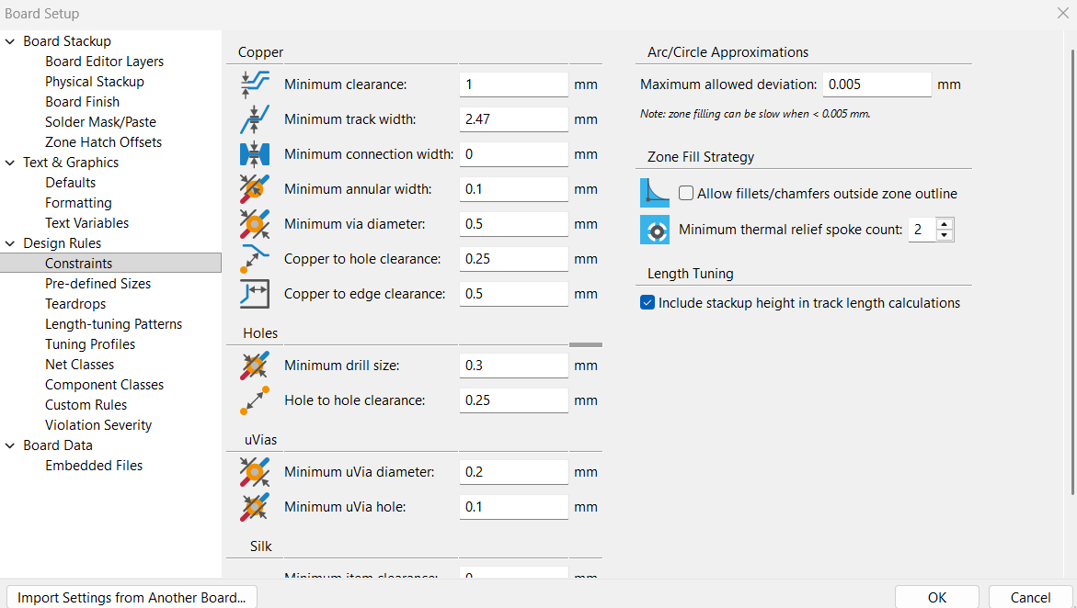
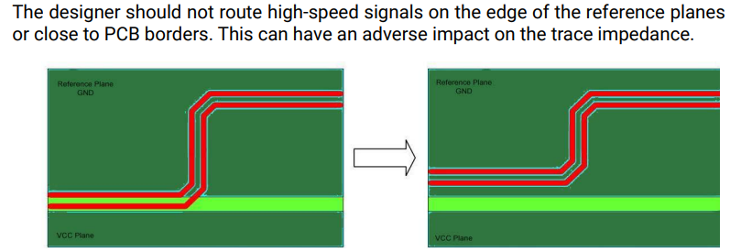
PCB Design – Board Setup (Design Rules)
Board set up updated to match PCB calculations
Minimum clearance (S) = 1 mm
Minimum track width (W) = 2.47 mm
Copper to edge clearance = 0.5 mm
Good practice

Slide 24
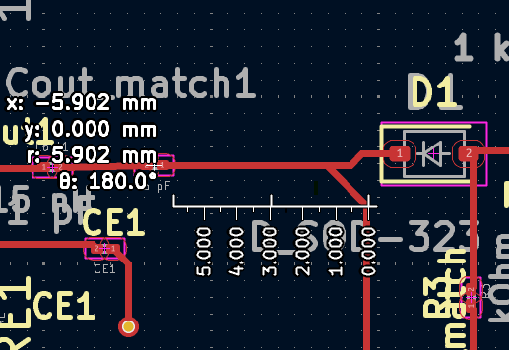
PCB Design – Component Placement
Requirements:
Largest trace = between LNA and Mixer
R = 5.902 (< 6mm)

Slide 25
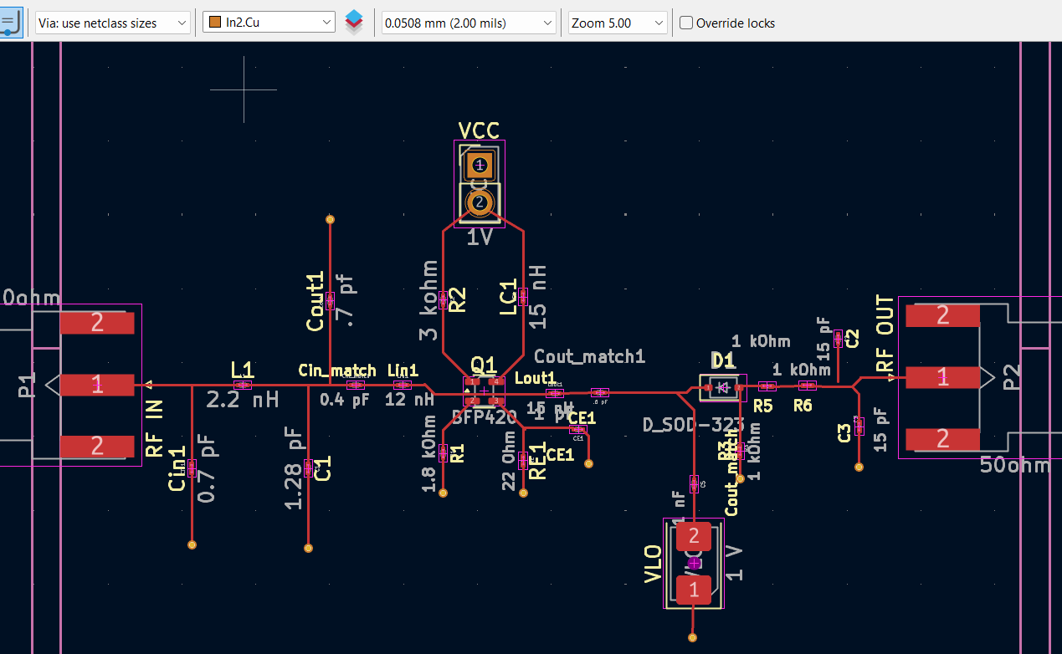

PCB Design – Vias
Requirements:
In2.Cu = layer 3 = Ground plane
(Ground plane was moved to layer 3 to allow for wider traces)
Layer 1
Layer 2
Layer 3
Layer 4
Vias
Vias

Slide 26
PCB Design - Final

Slide 27
Why is this circuit suitable for a bluetooth low energy reciever?
Single transistor requires low voltage (V = 3.3V)
Low power because P = IV
Passive diode mixer requires little to no DC power
unlike active gilbert cell mixer
Tuning from LC sections increases gain
Without increase in current
Again, low power because P = IV

Slide 28

Conclusion
Finally, we can have a low frequency (low energy) from LPF to IF Baseband output.
The IF Baseband Output itself can create the bluetooth low frequency at the receiver side.

Slide 29
Thank You
Any Clarifications?

